Slide 1
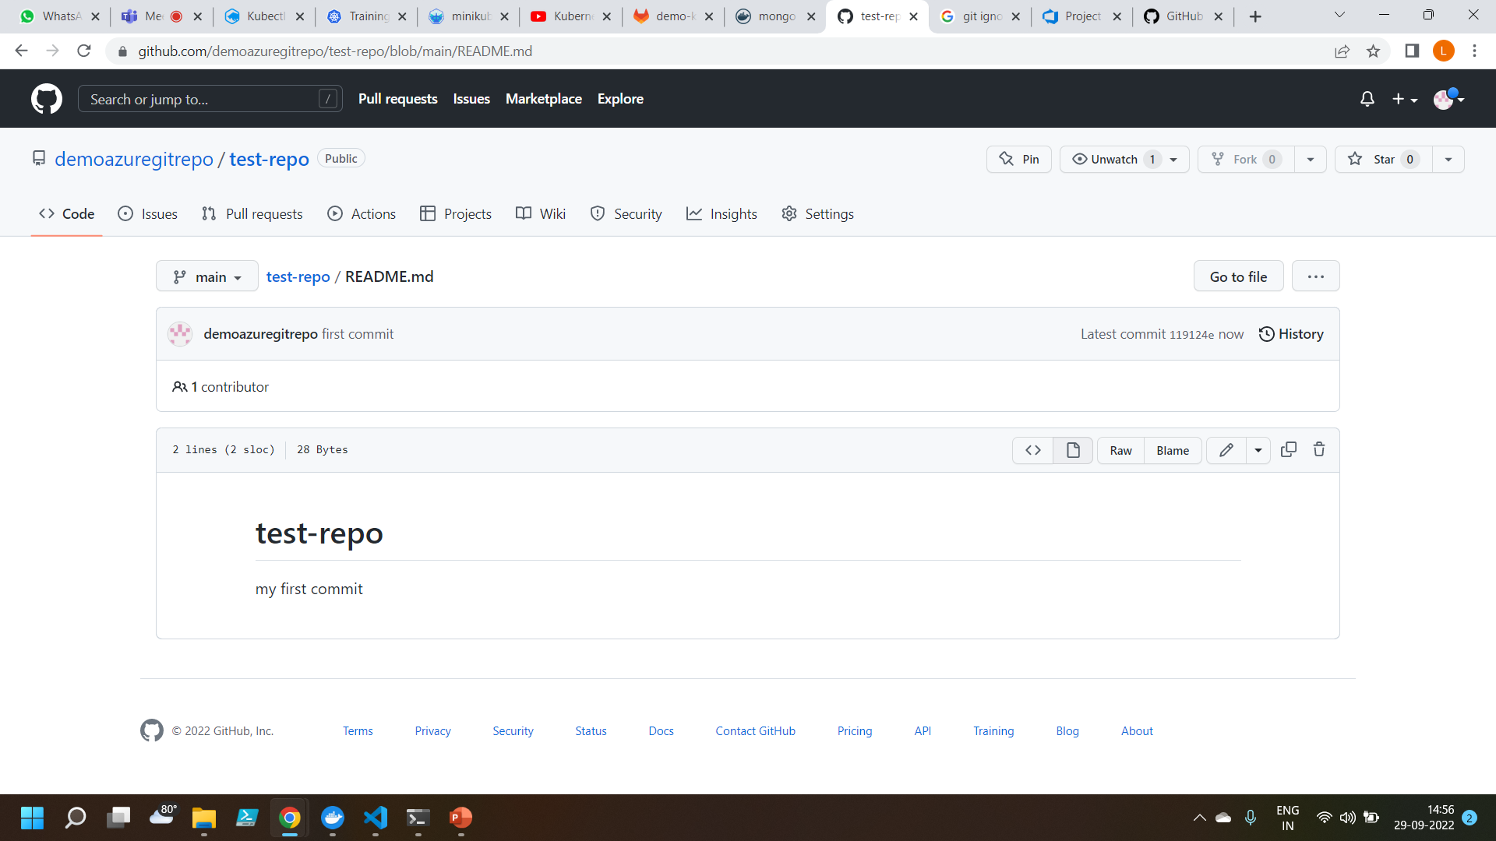
Github
Commiting a change to the new branch

Slide 2
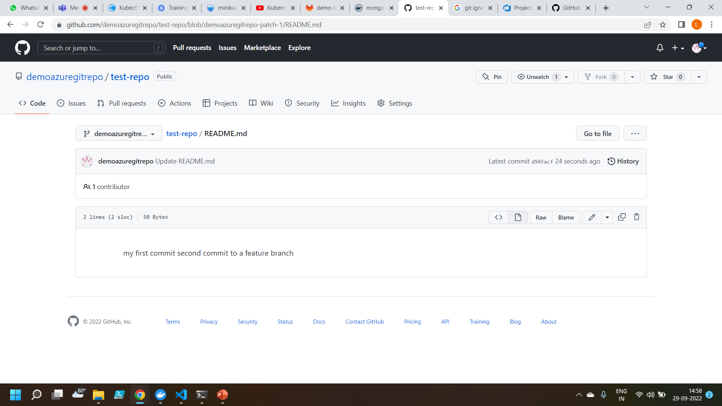
Commiting a change to the feature branch

Slide 3
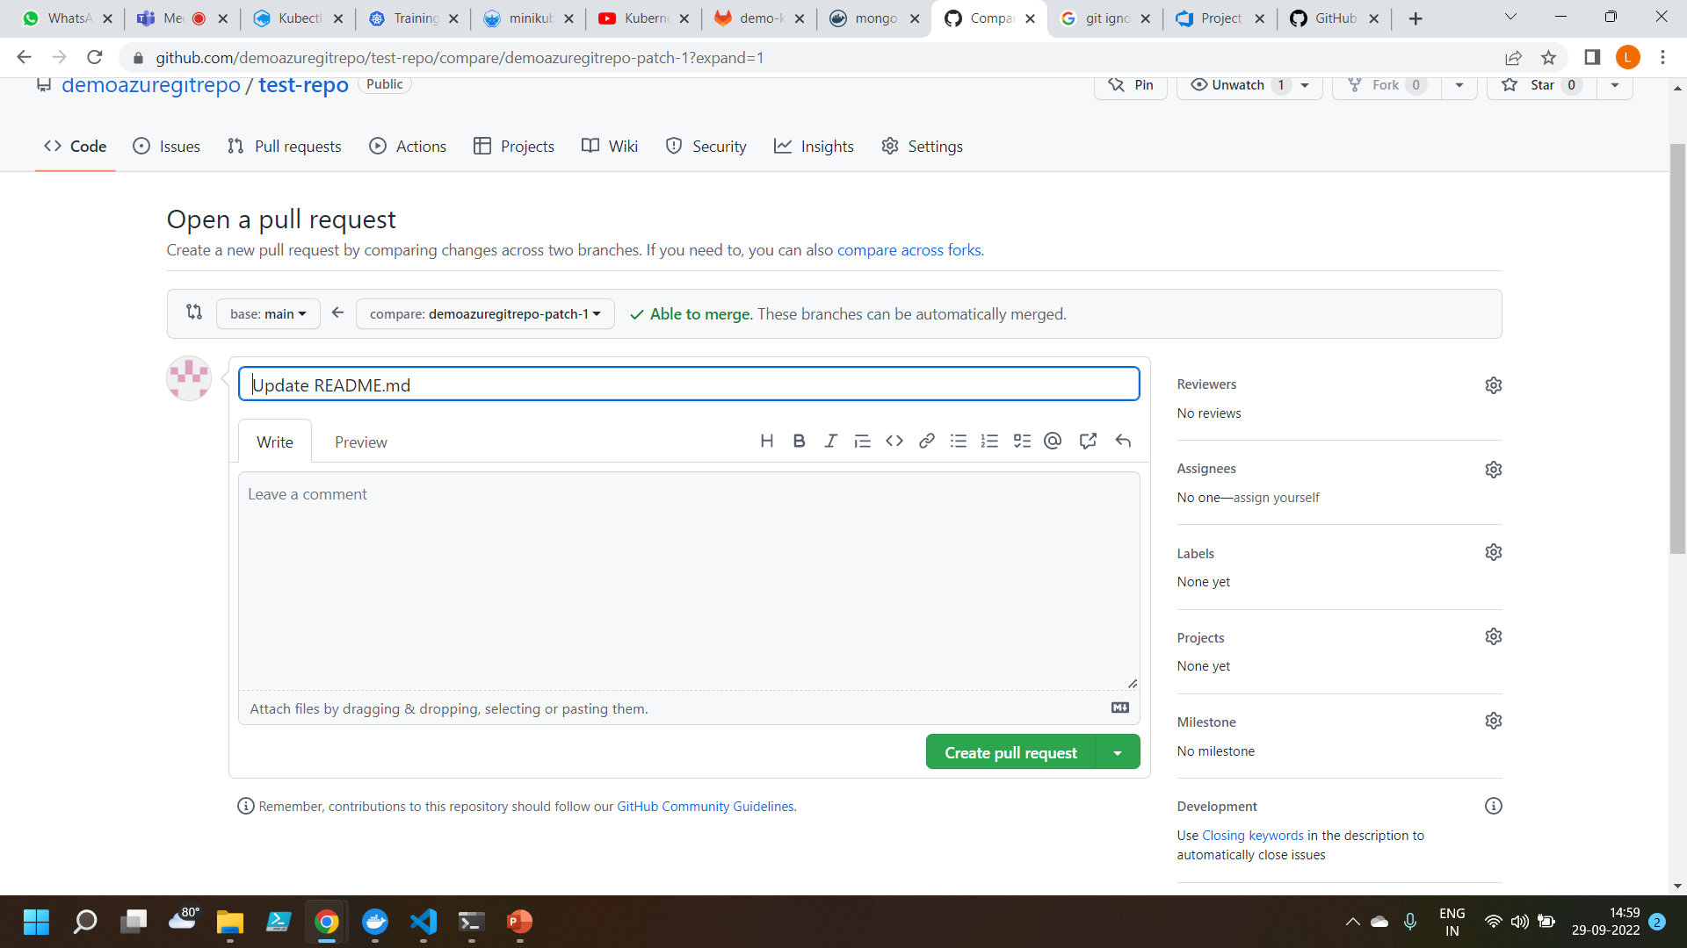
To Created a pull request to merge the code into the main branch

Slide 4
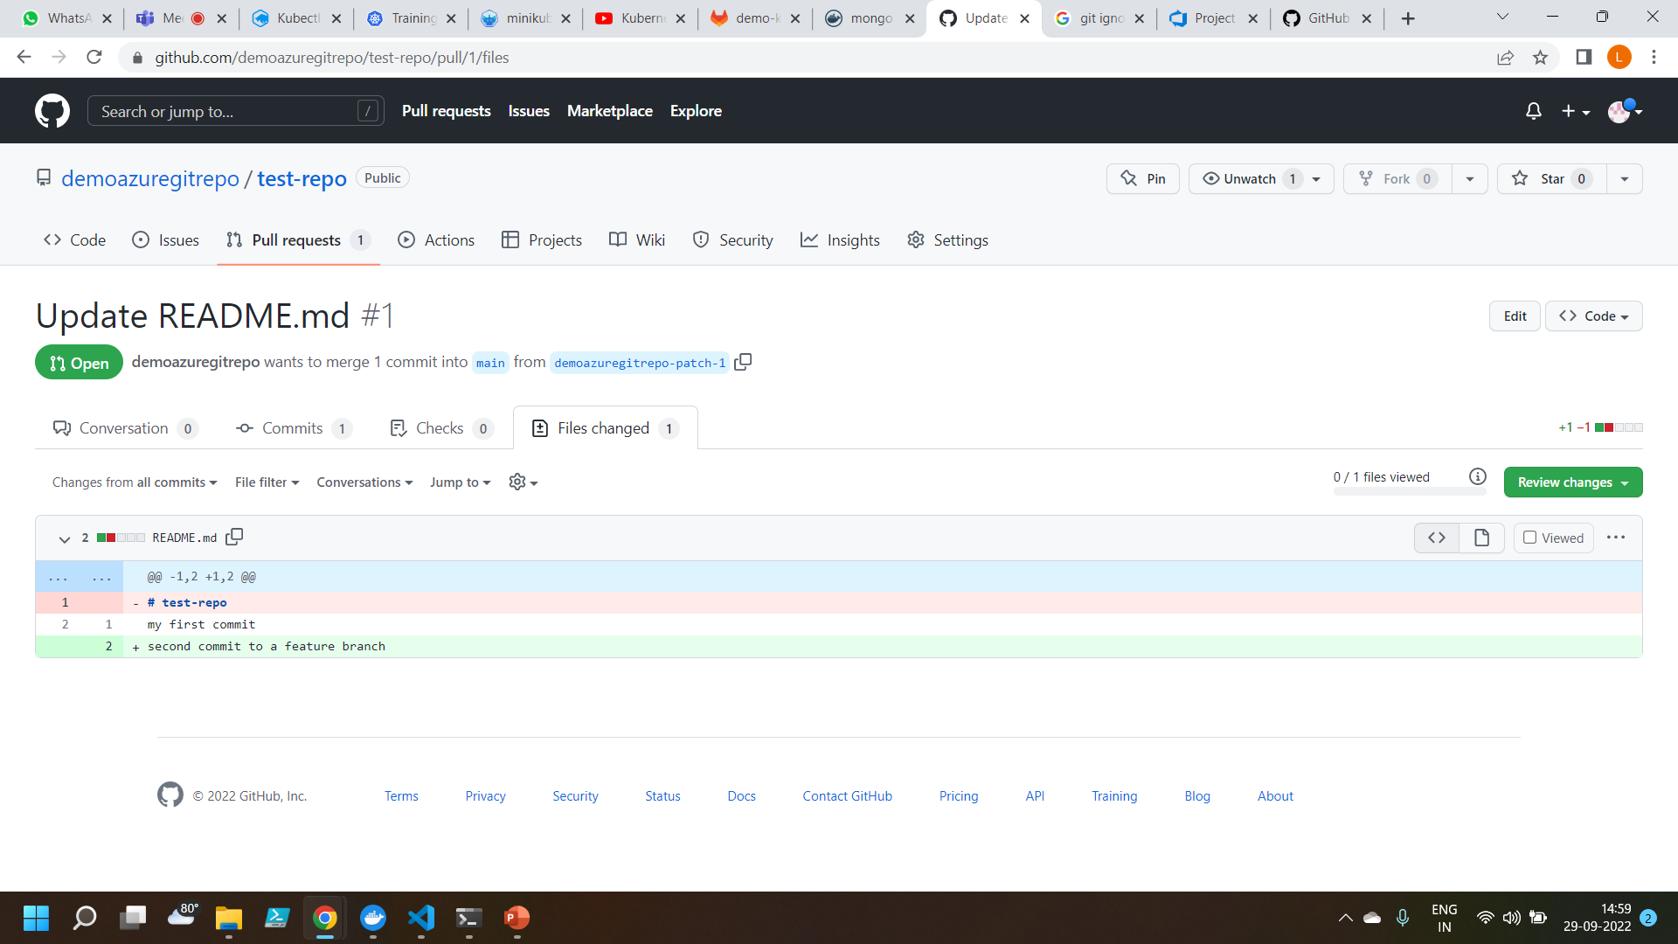
The Changes are merged into the main branch

Slide 5
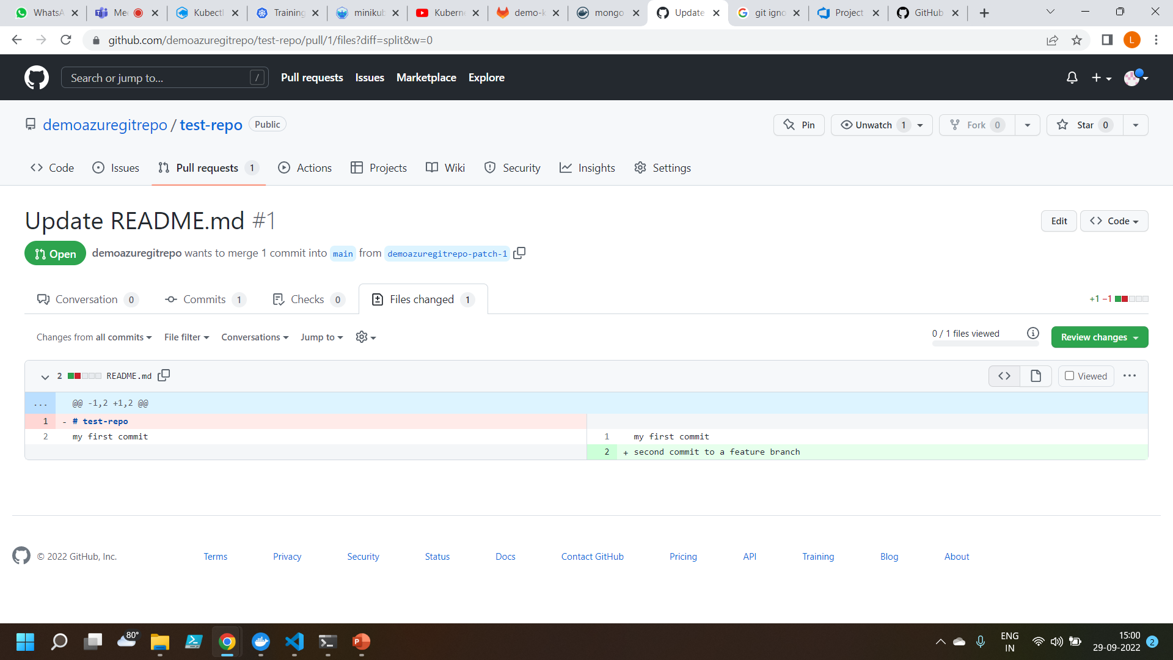
Insertion and deletion operations

